Slide 1
Virtual Reality Research and Development

Slide 2
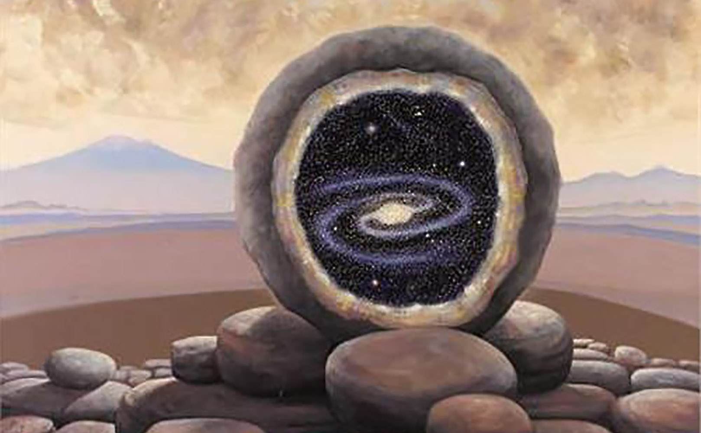
Ingo Swann - Geode

Slide 3
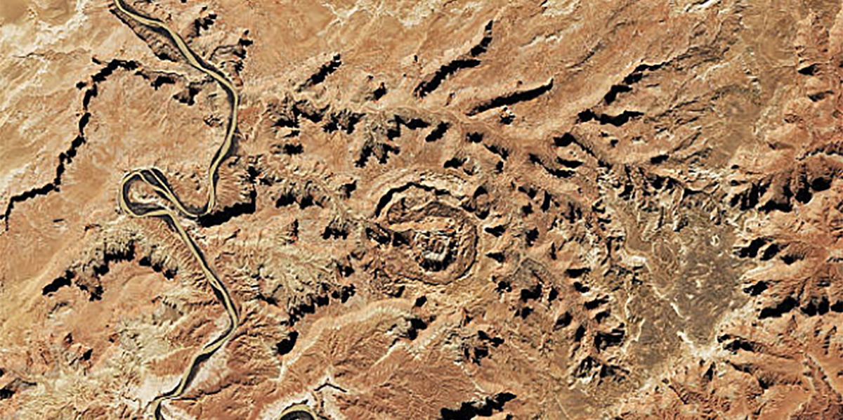
Problem
What process caused this formation?
Upheaval Dome – Canyonlands National Park - Utah

Slide 4
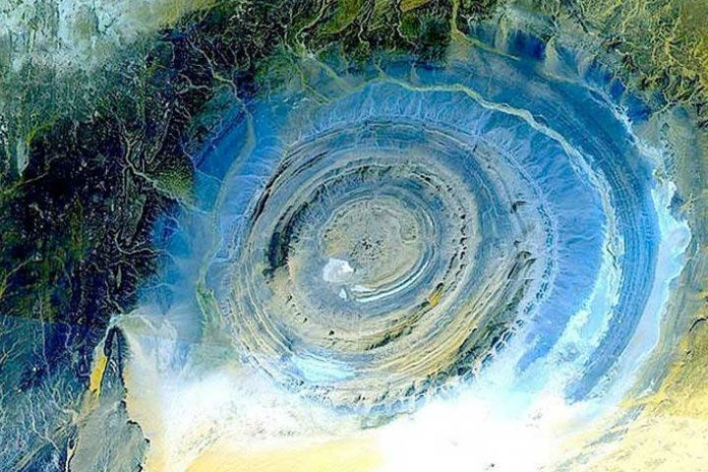
Problem
The earth’s morphology shows us that entrenched geological theories do not match simple observation.
Richat Structure - Central Mauritania - Africa

Slide 5
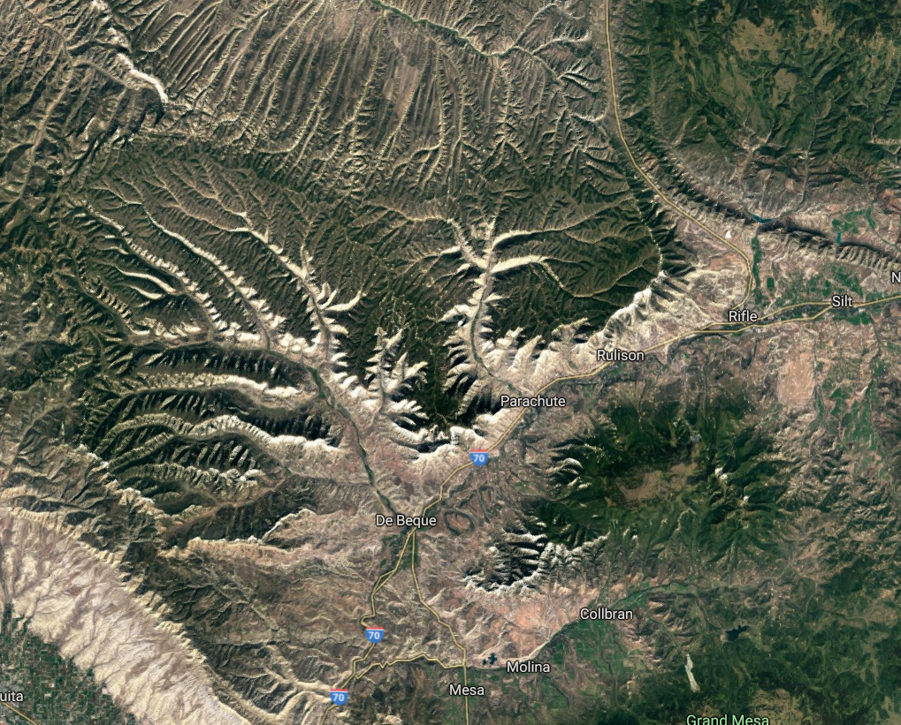
Problem
De Beque Canyon – Colorado
The Wave – Horseshoe Bend Arizona

Slide 6
Problem
The Wave – Horseshoe Bend Arizona

Slide 7
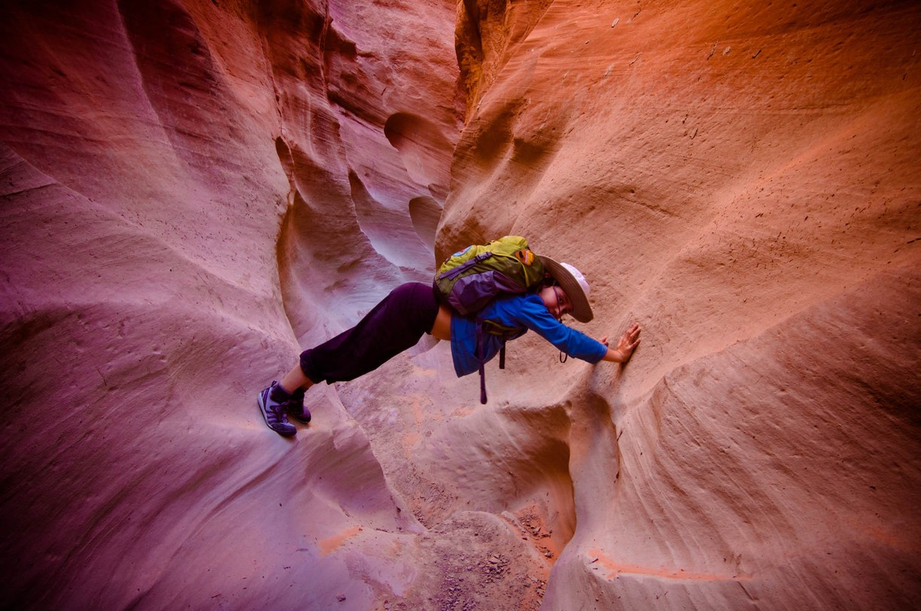
Problem
Grand Staircase-Escalante National Monument Kanab Utah

Slide 8
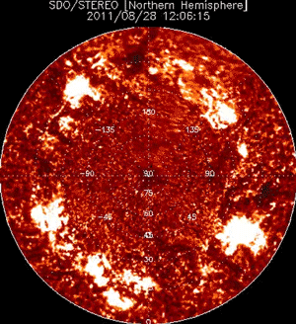
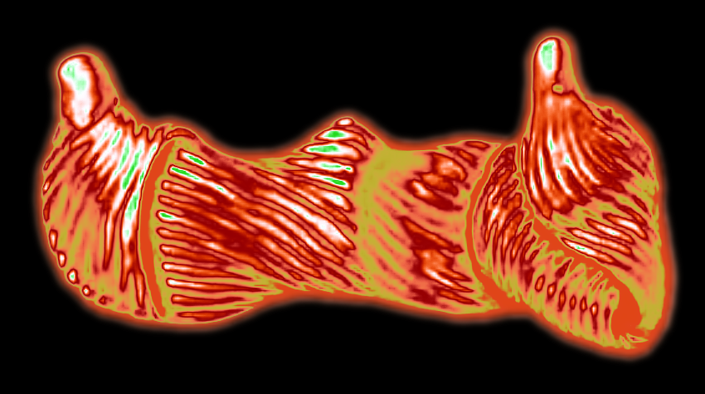
Problem
This holds true for other observable phenomena.

Slide 9
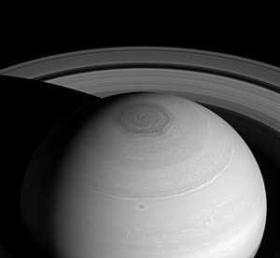
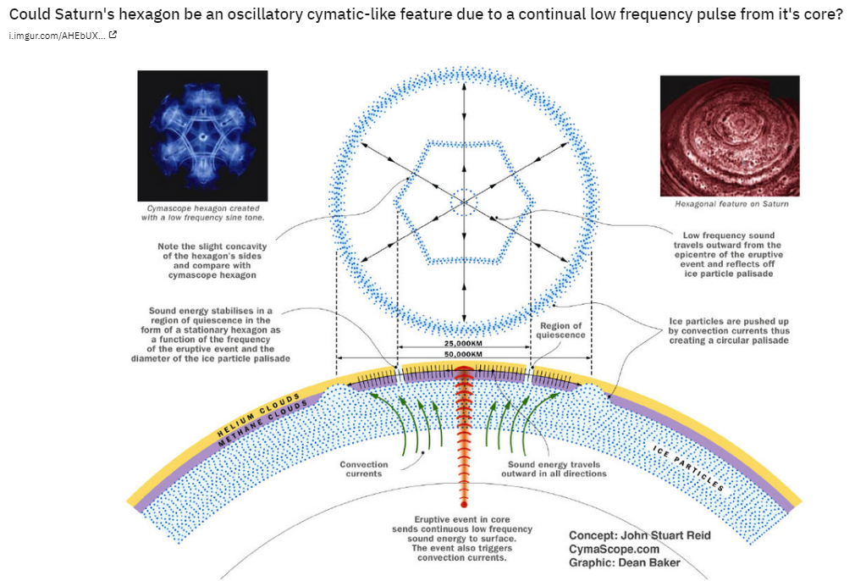
Problem

Slide 10
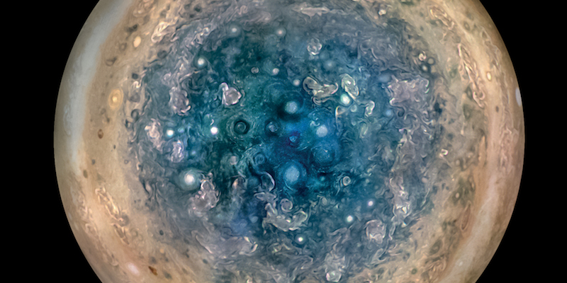
Problem

Slide 11
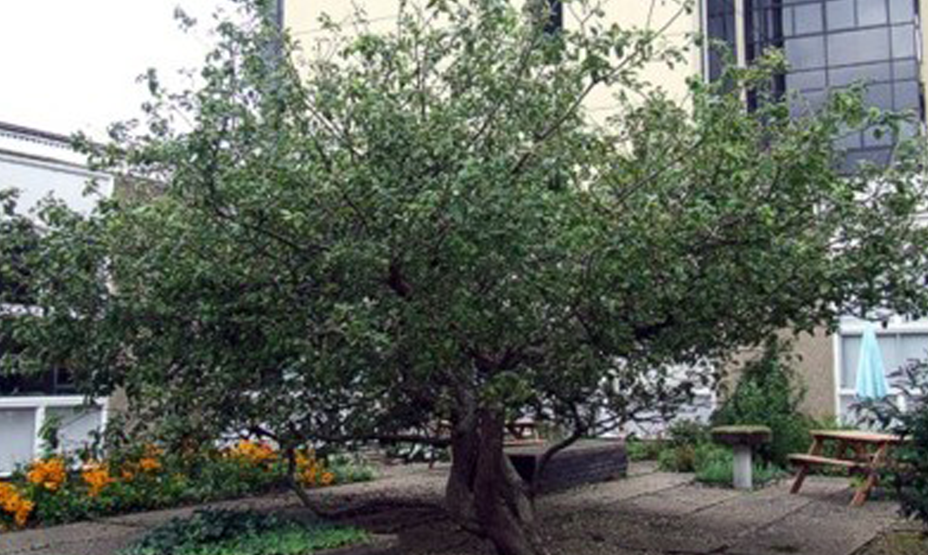
Problem
Isaac Newton might have focused equally on how the apple got up in the tree in the first place.

Slide 12
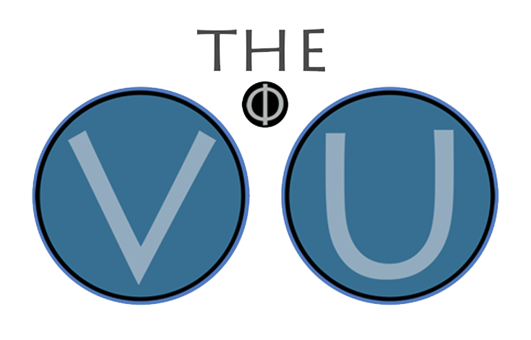
Solution : The VU – Organic Development
VR
Plasma Dynamics
VR
Morphology
Spline/Stylus
Editing Tools
Harmonic Resonance
VR
Cymatics
Voice Painting

Slide 13
Solution : Enthusiastic Community

Slide 14
Solution : Projects
The VU – Simulation Platform – 3D Charged Cloud Oscilloscope
Jim Weninger’s Filamentary Model of the Solar System
Plasma Dynamics – Birkeland Current Model
Lattice Boltzman Method – GPU – Electro Hydro Dynamics
Edo Kahl’s - Structured Atom Model
Terrence Howard – Vortex Dynamics – AllShape
Cymatics –Formants – Analysis and Visualization

Slide 15
Solution : VR Plasma Dynamics Simulation
Plasma, the fourth state of matter, presents a time/volume scalable medium to model and test hypotheses.
VR provides the ideal environment for intuitive, interactive configuration and simulation of plasma dynamics.
The VU is the Chemistry set you could only dream of as a burgeoning experimentalist (kid) – with no messy cleanup!
Simulations can be validated empirically through scaling and experimental design.

Slide 16
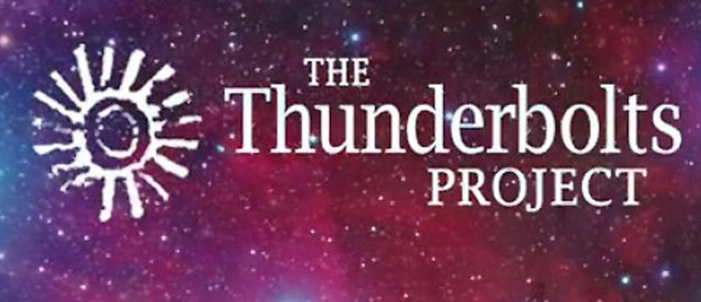
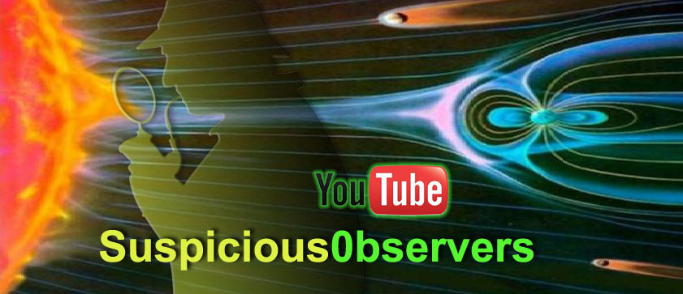
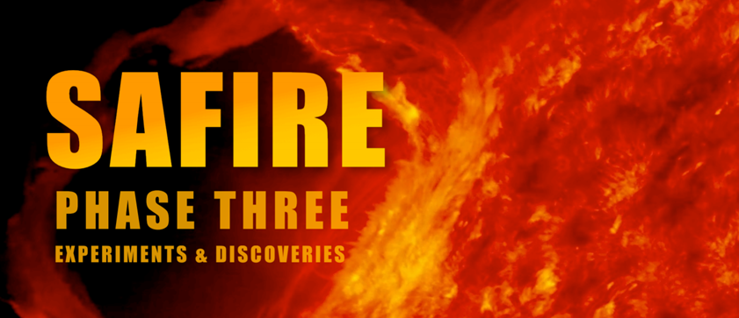
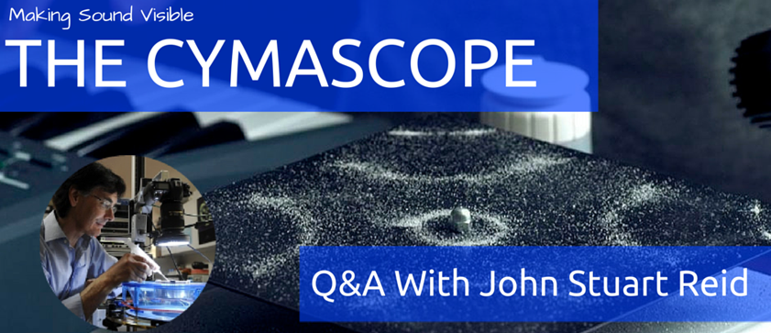
Competition - Collaboration

Slide 17
Market
The Thunderbolts Project holds popular yearly conferences presenting EU concepts.
Their YouTube channel has received more than 23,750,000 views since it’s inception in 2008.
SpaceWeatherNews is supported by a collective of more than 300,000 active subscribers.

Slide 18
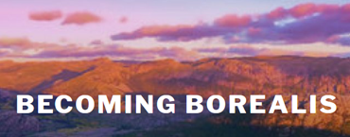
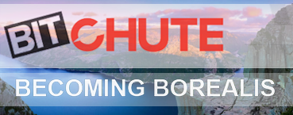
Traction

Slide 19
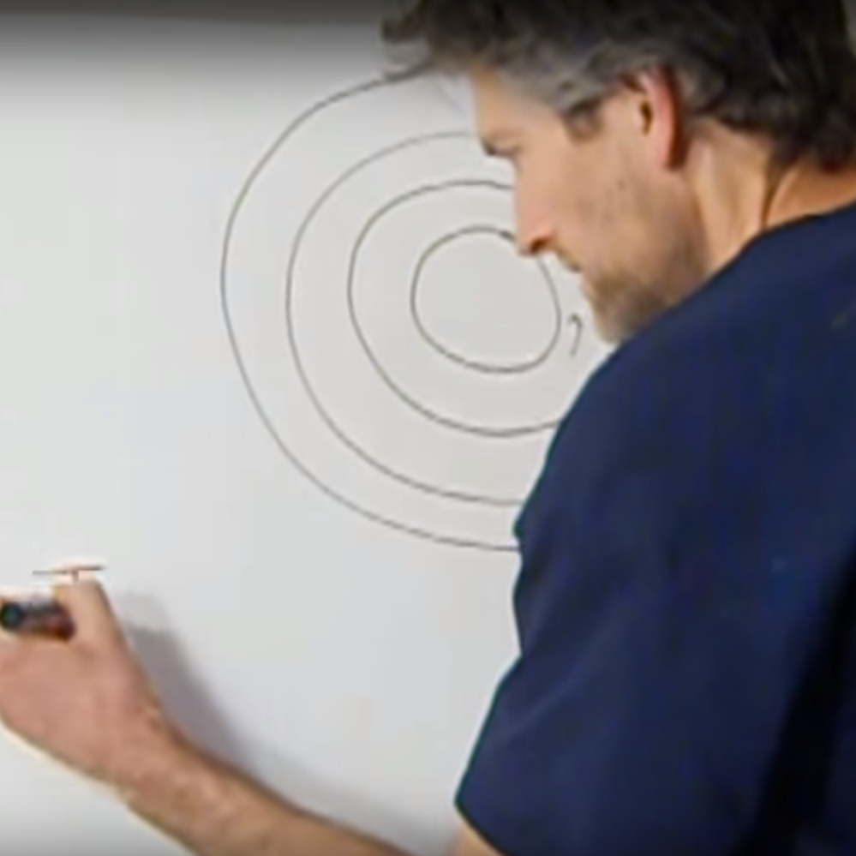
Team – Design & Development
James Weninger – Astrophysicist – Filamentary Model of the Solar System in the Interstellar Cloud – Arizona State University
Heather Hatcher – Author – A New Dawn – Waking up to the Electric Universe – The Art Institute of Michigan

Slide 20
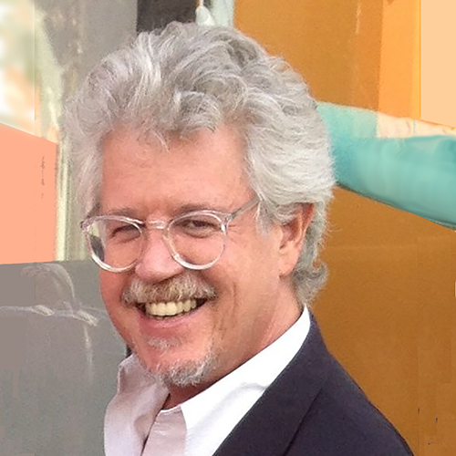
Team – Design & Development
Terrence Howard – Visionary and Renowned Actor – The All Shape – Fundamental Morphologies – Initial Stake Holder
David Johnson – Electrical Engineer – Primary Developer and Founder – FIT & Columbia University

Slide 21
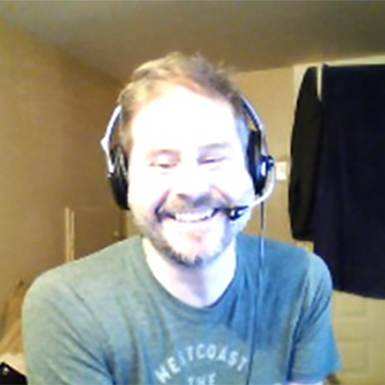
Team – Design & Development
Lukas Womak – Developer – Neuric Technologies – Initial Stake Holder – Business Development - SMU
Neil Thompson – EU Scholarship Award – EET
Host – The Electric View – Thunderbolts Conference coordination

Slide 22
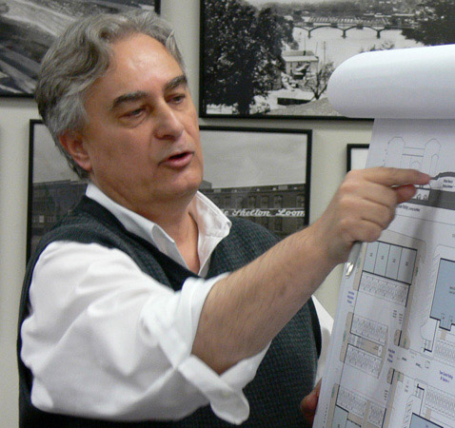
Team – Advisory Board
Richard Moore – Mathmatician and Author Spent 30 years in the Silicon Valley software industry, working for leading-edge companies, Xerox Parc, Apple Advanced Technology
Joeseph Matto Architect, AIA – Geometer – Tetra-Waveform – Pratt Institute – School of Architechture

Slide 23
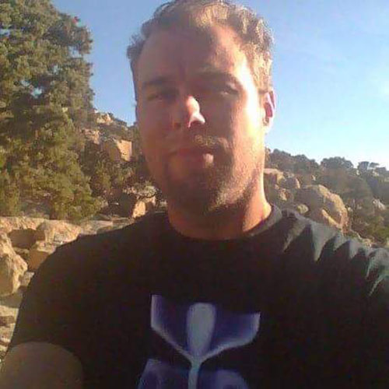
Team – Electric Geologists
Robert Hawthorne, Sr. Geologist, Gemologist Upheaval Dome Explorer – Associate of Gene Shoemaker – of Shoemaker Comet Fame
Robert Hawthorne, Jr. Geologist – Fulgarites – Geological Transmutation through Plasma Discharge

Slide 24
Income Pipelines
Virtual Geology Tours
See Geology with new Eyes
Experimental Modeling
Laboratory
Validation of Results
International
Conferences

Slide 25
The Future is Now

Slide 26
End of Presentation

Slide 27
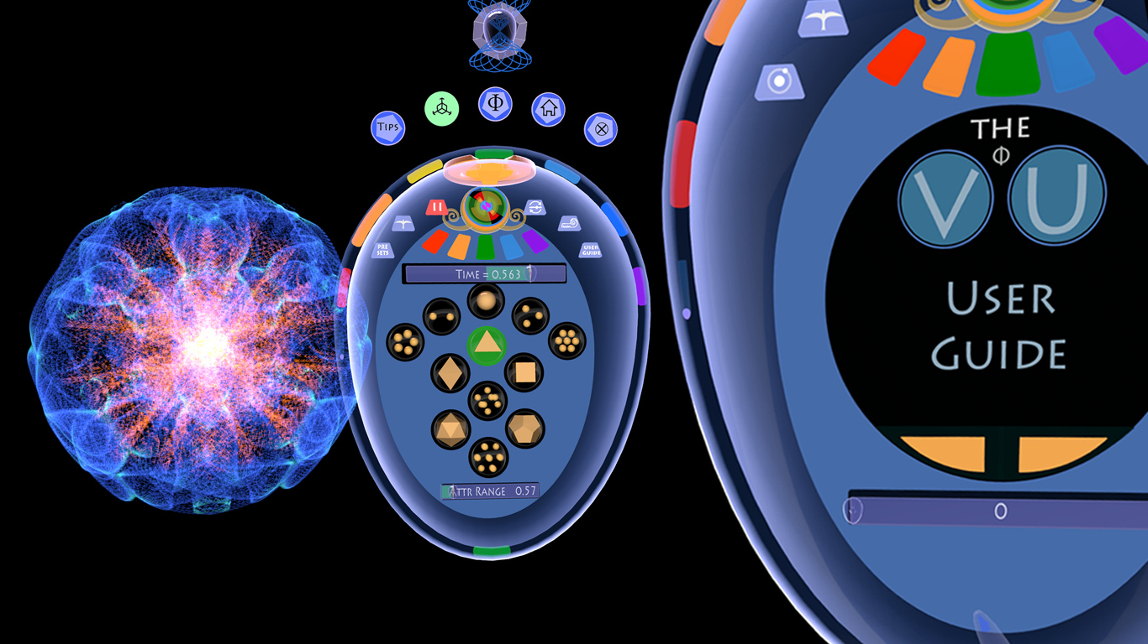
The VU

Slide 28
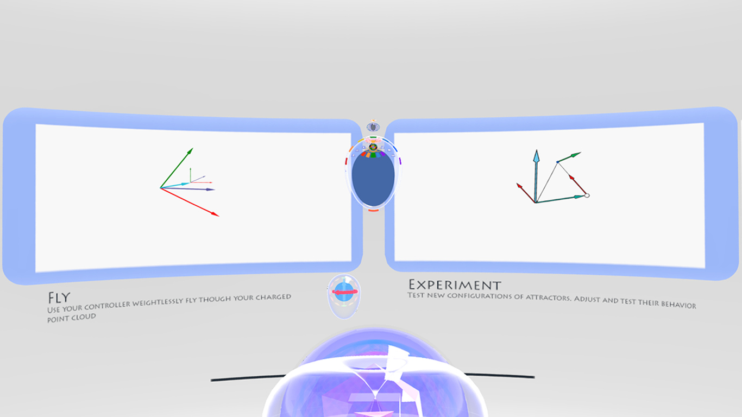

Slide 29
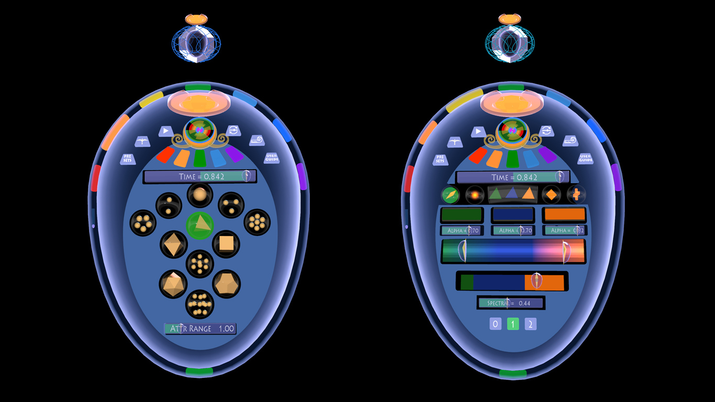

Slide 30
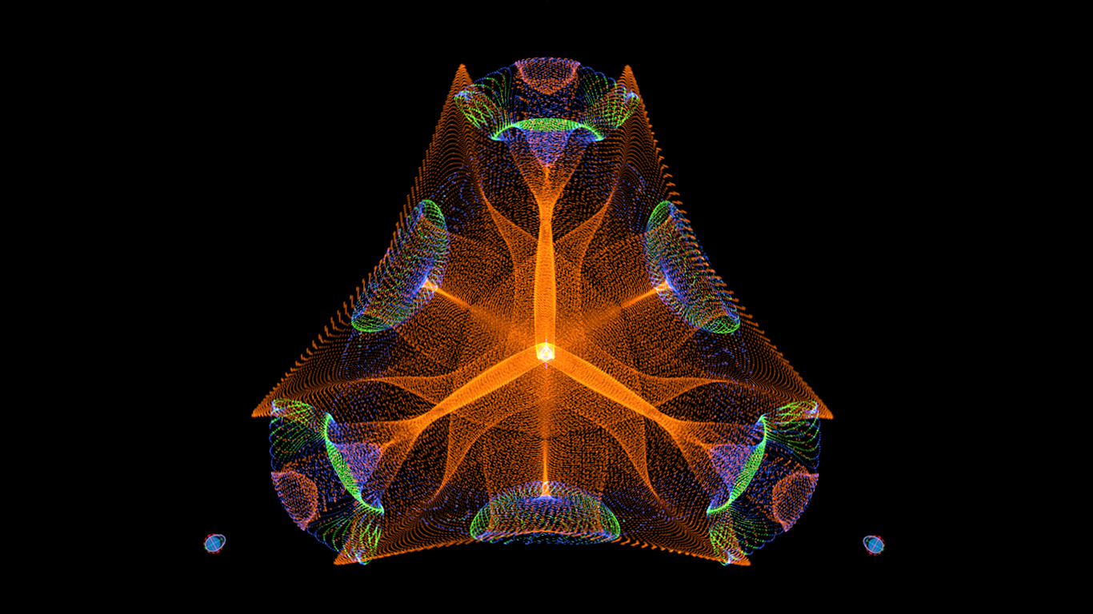

Slide 31
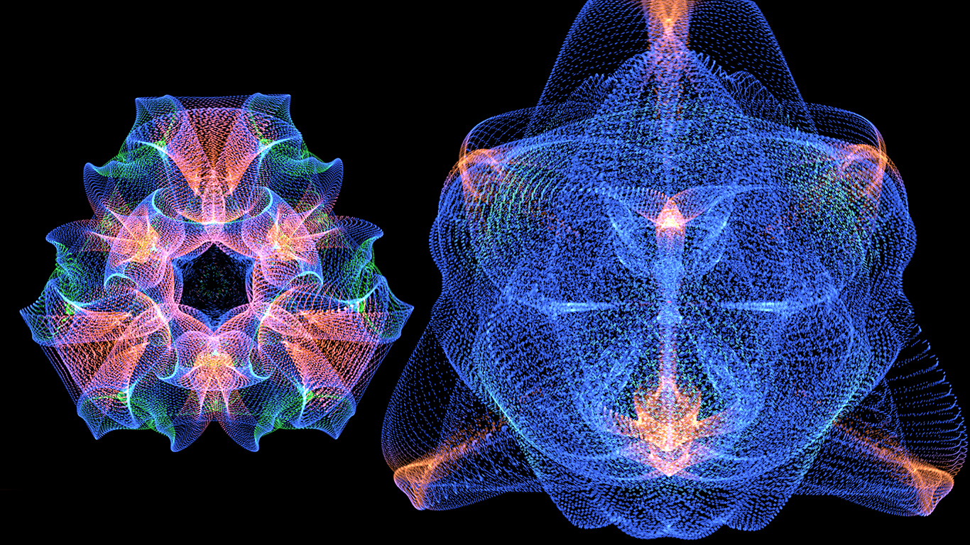

Slide 32
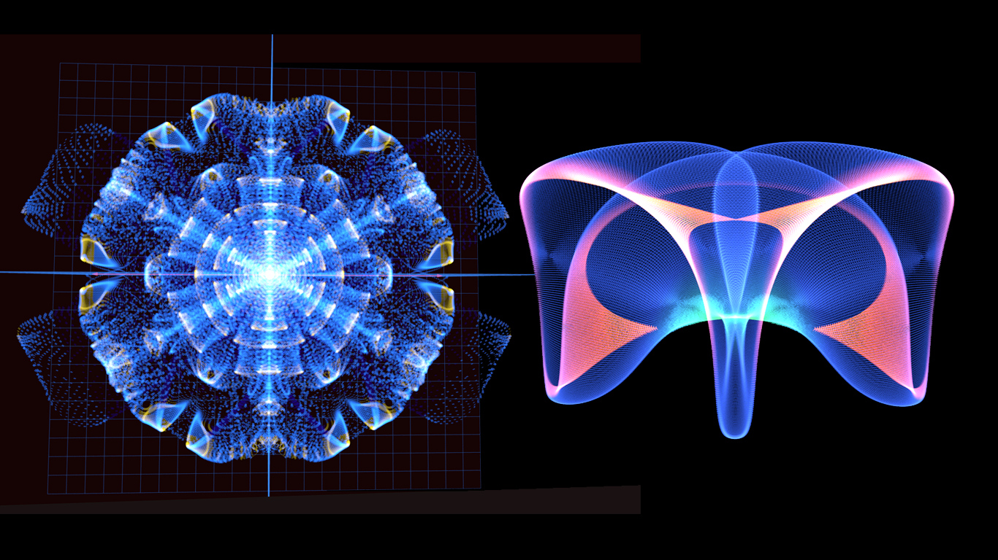

Slide 33
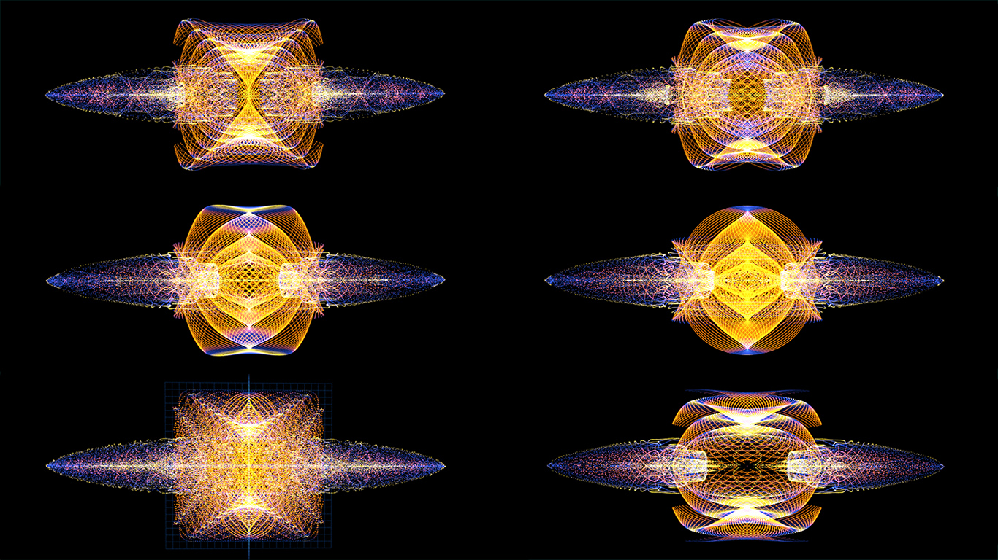

Slide 34
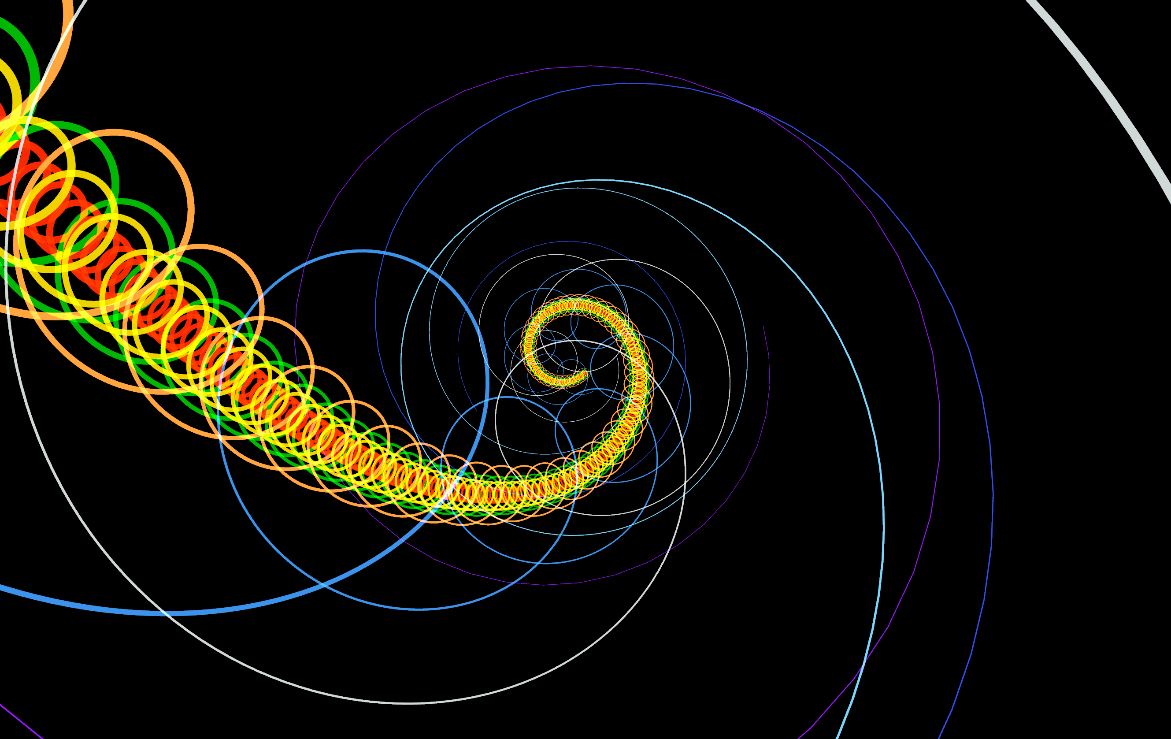
Jim Weningers Solar System Model

Slide 35
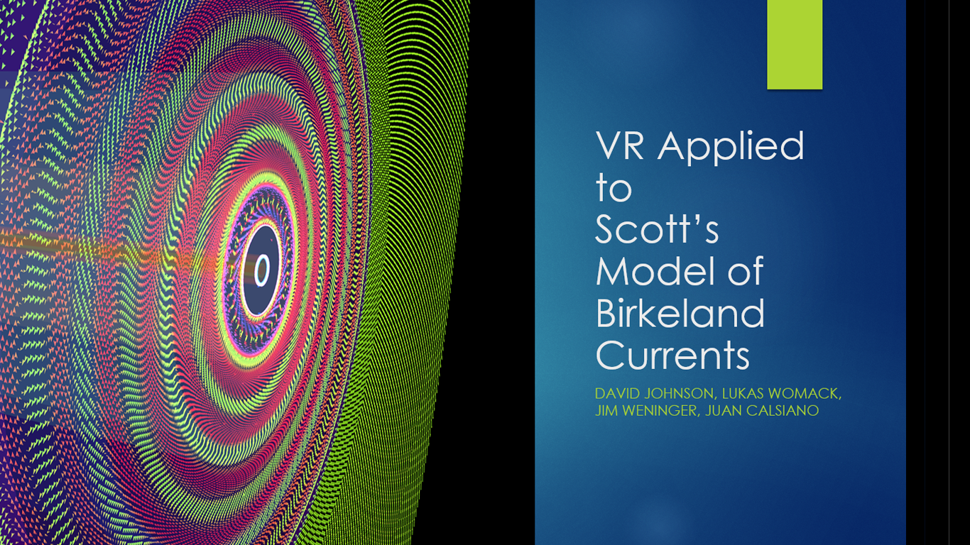
Plasma Dynamics – Birkeland Current Study

Slide 36
Steam & Viveport Early Access Pipeline

Slide 37
Terrence Howard Project

Slide 38
Vive Focus

